Slide 1

Project Presentation
on
“OWASP AI Model Watermarking”
Presented by
Shaikh Arfat Zakir [231846]
Daire Sami Navid [231813]
Ansari Mohamed Abdullah [231803]
Yash Bandiwadekar [231810]
Under the guidance of
Dr. Shafi Pathan
(Principal)
Department of Computer Science & Engineering (IoTCSBCT), MHSSCE, Mumbai

Slide 2

Outline
Team Responsibilities
Objectives
Problem Statement
Literature Review
Proposed Framework
System Architecture
System Workflow
Results
Working Prototype
Project Timeline and Progress
Outcomes and Future Work
References
Department of Computer Science & Engineering (IoTCSBCT), MHSSCE, Mumbai

Slide 3
Team Responsibilities
Arfat Shaikh – Frontend & Integration Developer
Builds the React dashboard, wires it to the backend APIs and packages the Python SDK and CLI.
Sami Daire – Project Lead, ZK Proofs & Verification
Designs the protocol and the Circom circuit, sets up Groth16 verification and integrates the system.
Mohamed Ansari – AI & Watermarking Developer
Builds embedding and detection for PyTorch, Keras and ONNX, and the attacks in the robustness study.
Yash Bandiwadekar – Backend Developer
Builds the demo server, the FastAPI + PostgreSQL backend and the APIs for verification history.
Department of Computer Science & Engineering (IoTCSBCT), MHSSCE, Mumbai

Slide 4
Objectives
  To develop a secure AI model watermarking system that embeds cryptographic watermarks into AI/ML models for verifiable ownership and intellectual property protection.
  To implement a privacy-preserving ownership verification mechanism using Zero-Knowledge Proof (ZKP), enabling authentication without revealing the embedded watermark.
  To evaluate the robustness of the embedded watermark against model modification attacks such as fine-tuning, pruning, quantization, compression, and model extraction while maintaining model performance.
Department of Computer Science & Engineering (IoTCSBCT), MHSSCE, Mumbai

Slide 5
Problem Statement
To develop a secure and robust AI model watermarking system that enables verifiable ownership authentication while protecting AI models against theft, tampering, and unauthorized use.
Research gap and our approach
Zero-knowledge ownership proofs such as ZKROWNN (DAC 2023) let the prover choose the watermark key, so a thief can forge a valid proof.
White-box marks are erased by channel permutation and by model extraction (SoK, IEEE S&P 2022).
Our approach: commit to a secret seed before release; the zero-knowledge circuit derives the key and signature from it, so a key can't be invented later.
Department of Computer Science & Engineering (IoTCSBCT), MHSSCE, Mumbai

Slide 6
Literature Review
Year | Paper | Methodology | Findings | Limitations
2017 | Uchida et al., Embedding Watermarks into DNNs [1] | Regulariser writes bits into one layer's weights | Survives fine-tuning and 65% pruning | Erased by channel permutation; no ownership proof
2018 | Adi et al., Watermarking DNNs by Backdooring [2] | Trigger set; its commitment is the verification key | Black-box check; ZK argument sketched | Efficient ZK proof left open
2018 | Rouhani et al., DeepSigns [3] | Mark in activation-map distributions | Generic white-box framework | Key is not committed
2019 | Fan et al., Embedding Passports [4] | Passport layers tied to model accuracy | Counters forged (ambiguity) claims | Changes the architecture
2019 | Li et al., Piracy Resistant Watermarks [5] | RSA-signed owner ID and timestamp, hashed into the mark | Resists a second, pirate watermark | Signature shown to an authority; no ZK
2021 | Jia et al., Entangled Watermarks [6] | Mark entangled with task features | Survives model extraction | Black-box only; up to 0.81 pp accuracy cost
2022 | Lukas et al., SoK: DNN Watermark Robustness [7] | 11 schemes against removal attacks | None robust in practice | Evaluation only
2023 | Sheybani et al., ZKROWNN [8] | zk-SNARK proof of watermark extraction | Ownership without revealing the key | Key uncommitted, so proofs can be forged
2023 | Yang et al., FedZKP [9] | Hash of a public instance as the mark; ZK proof of the secret | Ownership in federated learning | Mark checked in the clear
2026 | Yao et al., NeuralMark [10] | Mark is the hash of a secret key | Blocks forging and overwriting | Key given to a trusted verifier; no ZK
Department of Computer Science & Engineering (IoTCSBCT), MHSSCE, Mumbai

Slide 7
Proposed Framework
Programming Languages: Python, TypeScript, Circom, Solidity
AI / Machine Learning: PyTorch, TensorFlow / Keras, ONNX, NumPy, scikit-learn
Cryptography & Security: SHA-256, Poseidon hash, Ed25519 (ECC) signatures, Circom + SnarkJS (Groth16 zk-SNARK)
Web Development: React + TypeScript (Vite), FastAPI, a local Python demo server
Database & Storage: PostgreSQL 16 (SQLAlchemy, Alembic)
Development Tools: Visual Studio Code, Jupyter Notebook, Git & GitHub Actions, Hardhat (local blockchain)
Model Formats: .pt, .h5 / .keras, .onnx
Department of Computer Science & Engineering (IoTCSBCT), MHSSCE, Mumbai

Slide 8
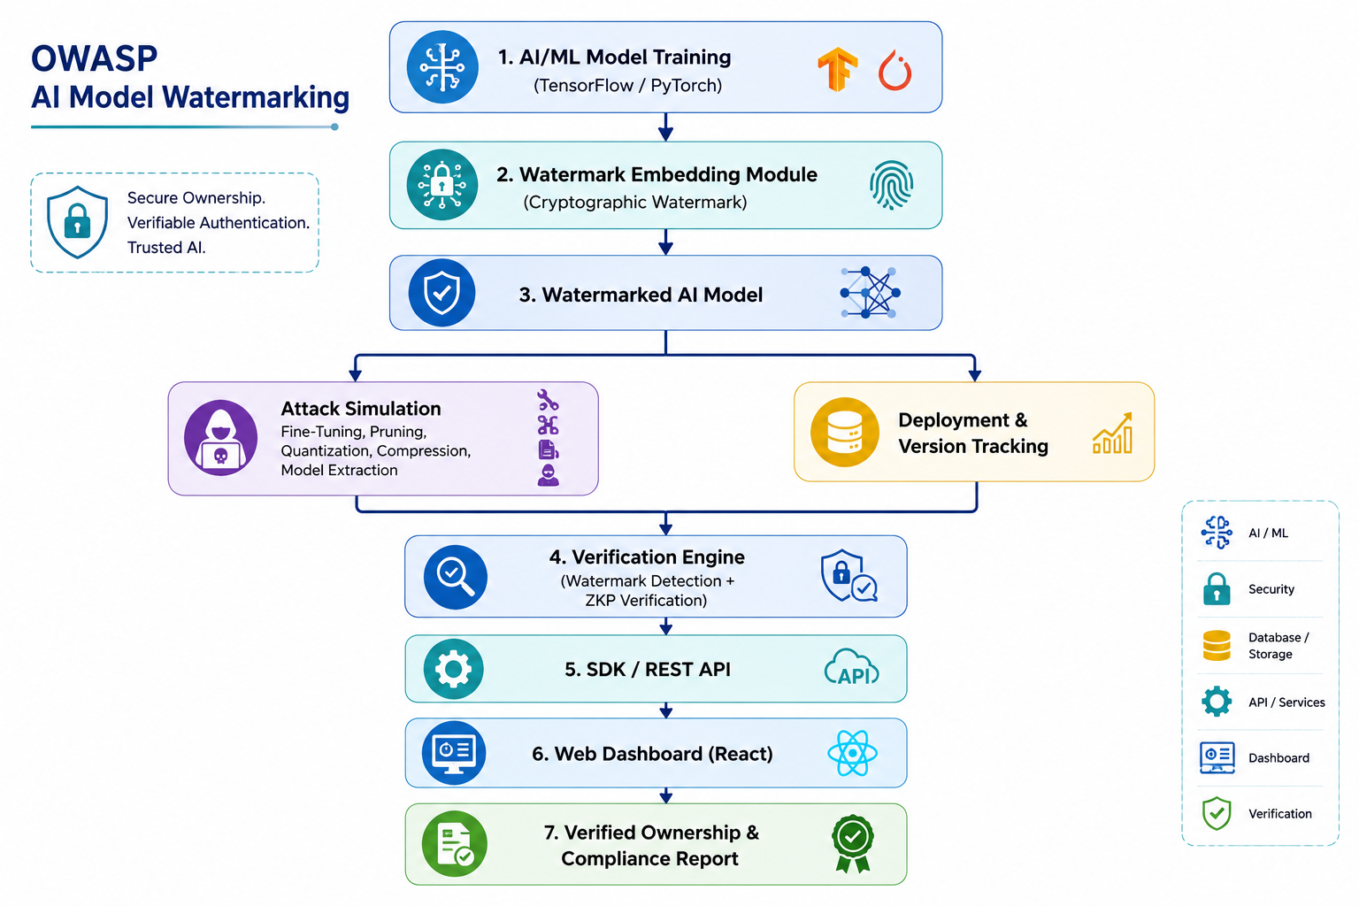
Department of Computer Science & Engineering (IoTCSBCT), MHSSCE, Mumbai

Slide 9
System Workflow
1
2
3
4
5
Create identity
Owner makes an Ed25519 key pair and a secret seed; both stay encrypted.
Embed
A key and a 64-bit signature derived from the seed are trained into one layer.
Register
Signed record with the seed's commitment and the model hash; a registry timestamps it.
Claim
A verifier opens a claim on a suspect file, with a fresh random nonce.
Prove & verify
Groth16 proof that the committed mark is in this file (at most 8 of 64 bits wrong).
The verifier checks: the owner's signature, a registry timestamp earlier than the claim, that the claim matches this file, every public signal recomputed from the file itself, and the Groth16 proof (12 checks, each with its own reason).
Department of Computer Science & Engineering (IoTCSBCT), MHSSCE, Mumbai

Slide 10
Results
Robustness
−0.03 pp
accuracy cost of the 64-bit mark
Survives 90% pruning, 4-bit quantisation, fine-tuning and a thief's overwrite
Channel permutation scrambles it; the owner's realignment restores it
0 of 30 never-marked models accepted (rule: at most 8 of 64 bits wrong)
Forgery and our fix
0 / 20,000
forgeries against the committed seed
Without a commitment, a thief's fake key reads "MALLORY!" with 0 bits wrong
With EZKL, the forged proof verifies under the owner's own key
A thief needs about 2³² tries at 64 bits, 2¹²⁰ at 256 bits
Zero-knowledge proof cost
3.9 s
to prove, 0.41 s to verify (64-bit mark)
741-byte proof (EZKL: about 61 KB)
Also verified on-chain, for 243,225 gas
256-bit mark: 11.6 s to prove, 5.0 GiB peak memory
Department of Computer Science & Engineering (IoTCSBCT), MHSSCE, Mumbai

Slide 11
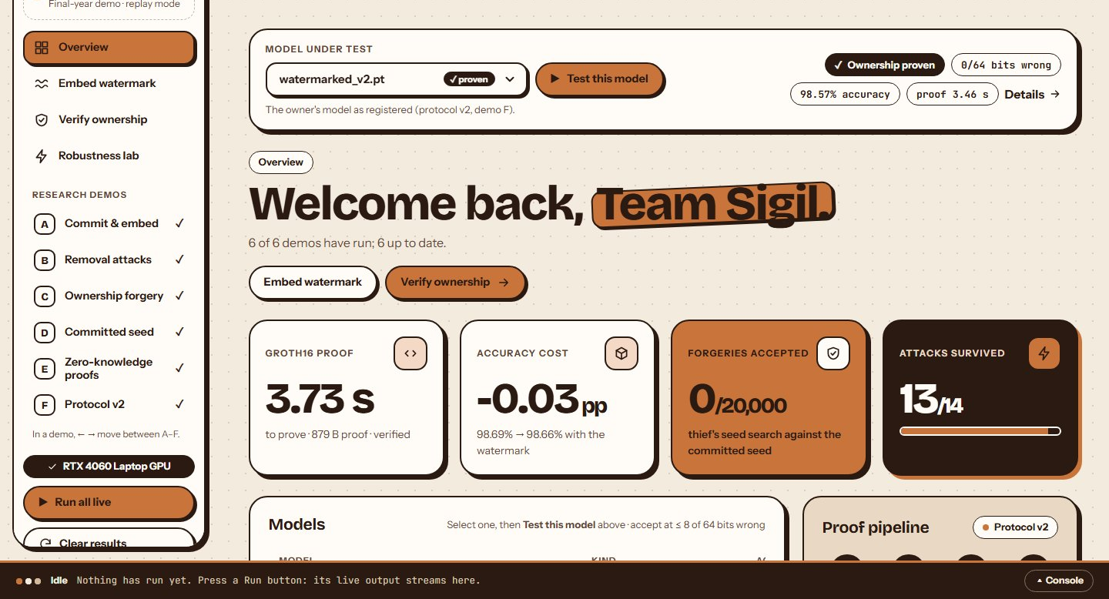
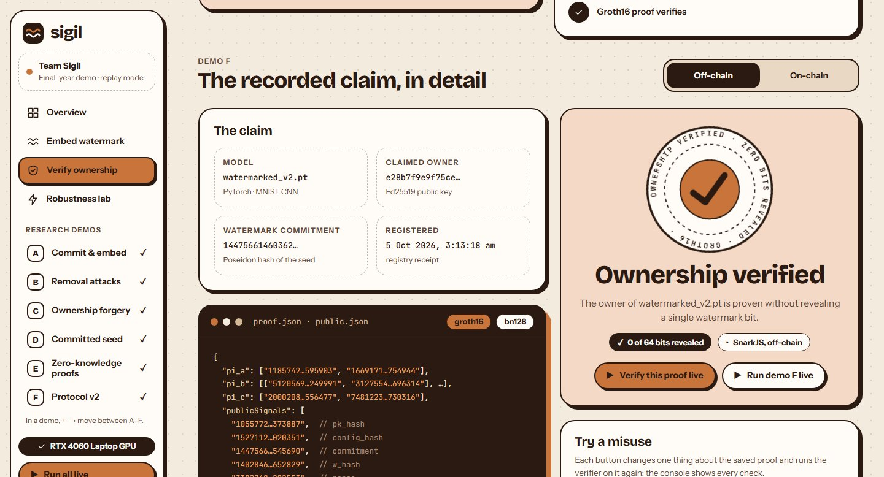
Working Prototype
Dashboard: the six demos run live on this laptop and the headline results update.
Verify ownership: the claim, the Groth16 proof, every check and the verdict.
Department of Computer Science & Engineering (IoTCSBCT), MHSSCE, Mumbai

Slide 12
Project Timeline and Progress
Weeks | Work | Status
W1 | Set-up and fixes to the first build | Done
W2–W4 | Protocol v2: commitment, owner identity, registry timestamps | Done
W3–W8 | Zero-knowledge pipeline; SDK for PyTorch, Keras and ONNX (491 tests pass) | Done
W9–W10 | Semester 7 review | Upcoming
W11–W15 | Robustness study (MNIST done, CIFAR-10 next); FastAPI + PostgreSQL backend built | In progress
W15–W17 | Integration, evaluation and documentation | Planned
W18–W23 | New dashboard on the FastAPI backend | Planned
W24–W26 | Final report and viva | Planned
Department of Computer Science & Engineering (IoTCSBCT), MHSSCE, Mumbai

Slide 13
Outcomes and Future Work
Expected outcome | Status | Evidence
Secure watermarking for ownership | Achieved | 64-bit mark, accuracy 98.69% → 98.66%; PyTorch, Keras and ONNX
Detection and cryptographic verification | Achieved | Ed25519-signed, timestamped registrations; 12 verifier checks
Privacy-preserving ZKP authentication | Achieved | Circom + Groth16 proof in 3.9 s; also verified on-chain
Robustness to modification attacks | Partly | Survives pruning, quantisation, fine-tuning, overwriting; permutation needs realignment; model extraction removes it
Framework-agnostic SDK / API | Achieved | sigil SDK and CLI: embed, detect, register, prove, verify, attack, report
Dashboard and compliance reporting | Partly | Demo dashboard works; backend with reports built; new UI planned
Future work: CIFAR-10 ResNet-18 and 256-bit evaluation · a defence against model extraction · the new dashboard on the backend · the final report.
Department of Computer Science & Engineering (IoTCSBCT), MHSSCE, Mumbai

Slide 14
References
[1] Uchida, Nagai, Sakazawa and Satoh, "Embedding Watermarks into Deep Neural Networks," ACM ICMR, pp. 269–277, 2017.
[2] Adi et al., "Turning Your Weakness Into a Strength: Watermarking Deep Neural Networks by Backdooring," USENIX Security, pp. 1615–1631, 2018.
[3] Rouhani, Chen and Koushanfar, "DeepSigns: A Generic Watermarking Framework for Protecting the Ownership of Deep Learning Models," arXiv:1804.00750, 2018.
[4] Fan, Ng and Chan, "Rethinking Deep Neural Network Ownership Verification: Embedding Passports to Defeat Ambiguity Attacks," NeurIPS, 2019.
[5] Li et al., "Piracy Resistant Watermarks for Deep Neural Networks," arXiv:1910.01226, 2019.
[6] Jia, Choquette-Choo, Chandrasekaran and Papernot, "Entangled Watermarks as a Defense against Model Extraction," USENIX Security, 2021.
[7] Lukas, Jiang, Li and Kerschbaum, "SoK: How Robust is Image Classification Deep Neural Network Watermarking?," IEEE S&P, 2022.
[8] Sheybani, Ghodsi, Kapila and Koushanfar, "ZKROWNN: Zero Knowledge Right of Ownership for Neural Networks," DAC, 2023.
[9] Yang et al., "FedZKP: Federated Model Ownership Verification with Zero-knowledge Proof," arXiv:2305.04507, 2023.
[10] Yao, Song and Jin, "Hashed Watermark as a Filter: Defeating Forging and Overwriting Attacks in Weight-based Neural Network Watermarking," AAAI, 2026.
Department of Computer Science & Engineering (IoTCSBCT), MHSSCE, Mumbai

Slide 15
Thank You

